Slide 1
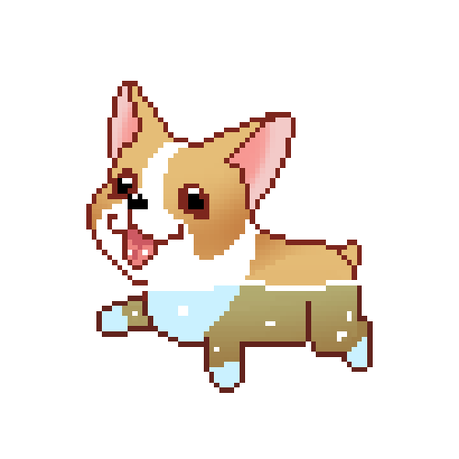
RABIES
contagious disease
Oliwia Jerzowska Ia

Slide 2
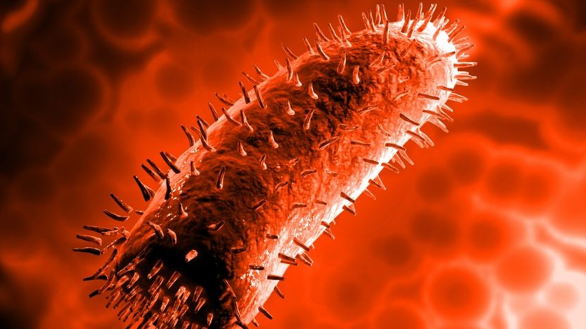
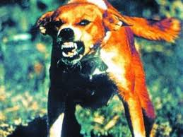
What is rabies?
Rabies is a viral disease that causes inflammation of the brain in humans and other mammals. Early symptoms can include fever and tingling at the site of exposure. These symptoms are followed by one or more of the following symptoms: violent movements, uncontrolled excitement, fear of water, an inability to move parts of the body, confusion, and loss of consciousness. Once symptoms appear, the result is nearly always death. The time period between contracting the disease and the start of symptoms is usually one to three months, but can vary from less than one week to more than one year. The time depends on the distance the virus must travel along peripheral nerves to reach the central nervous system.
rabies virus picture
dog with rabies :(
https://en.wikipedia.org/wiki/Rabies

Slide 3
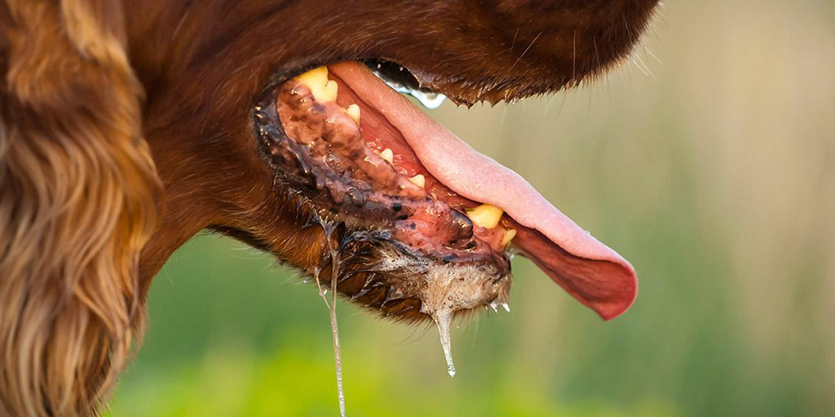
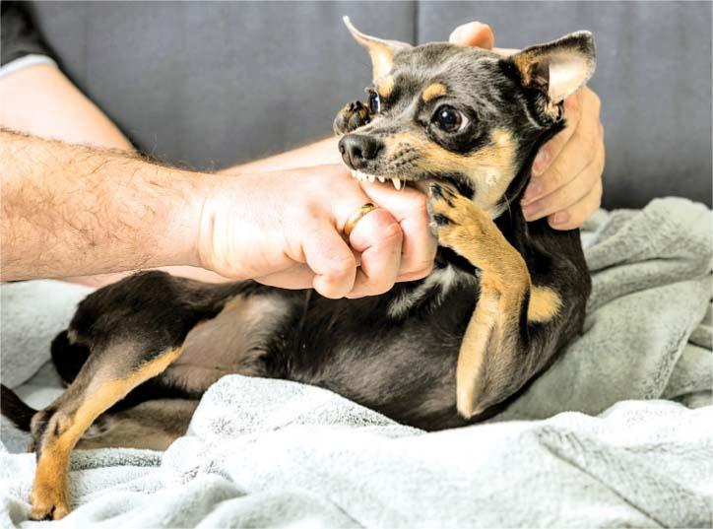
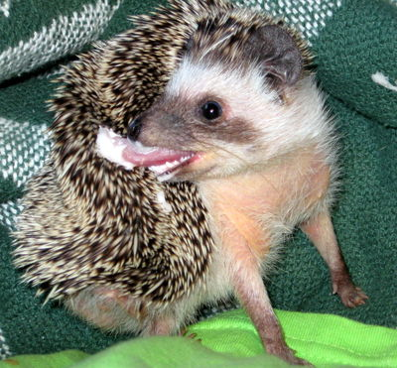
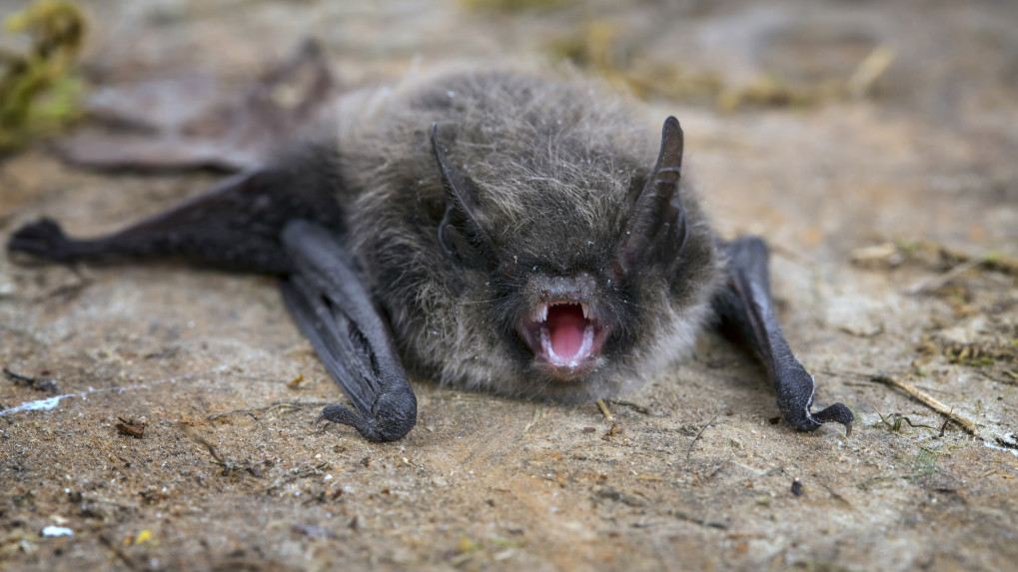
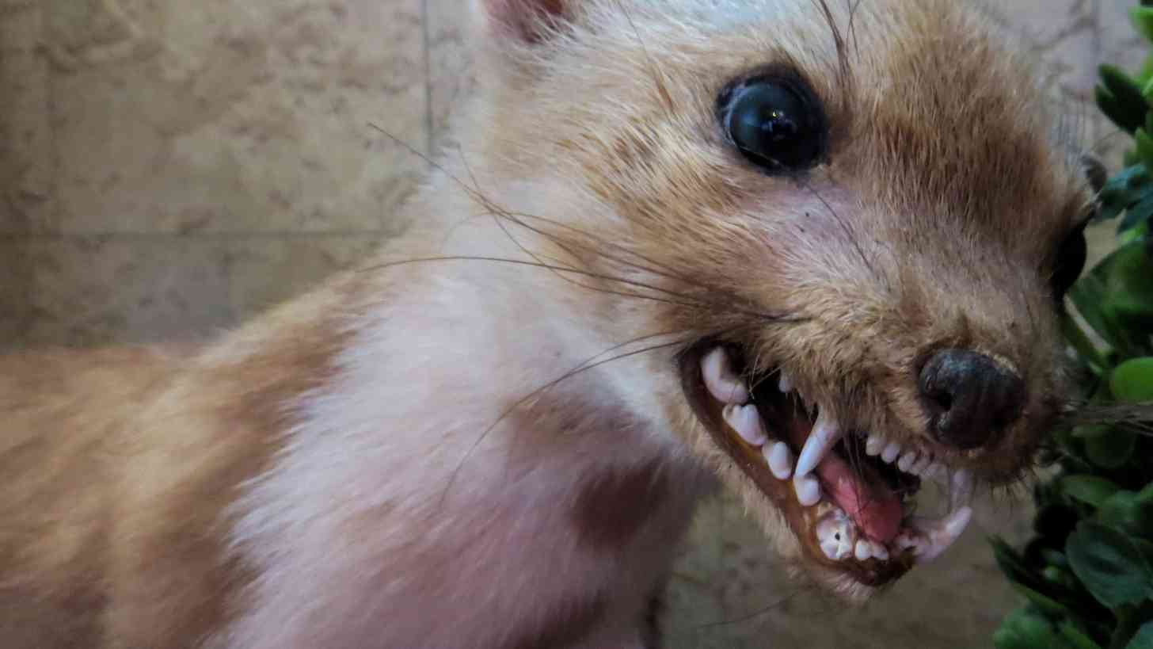
Rabies in animals
In animals, the disease lasts from 1 to 8 days and is characterized primarily by a change in behavior. Calm animals become aggressive and vice versa. Wild animals rub the natural fear of people. In addition, there are paresis and paralysis of the limbs, swallowing disorders, leakage of saliva. After this period, the animals die.
https://www.medonet.pl/zdrowie/zdrowie-dla-kazdego,wscieklizna-u-ludzi-i-zwierzat---objawy--leczenie,artykul,1644491.html

Slide 4
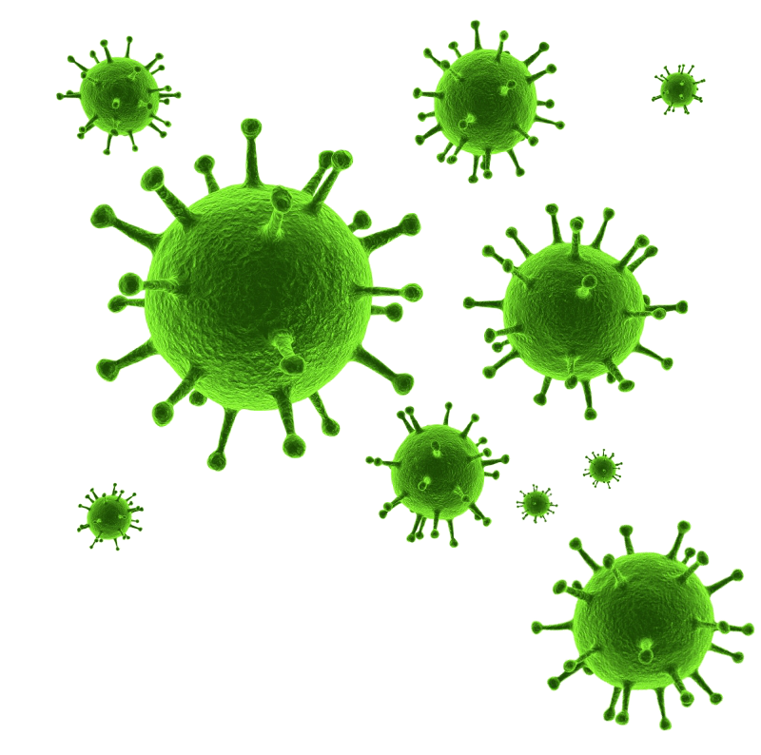
Who can get rabies?
animals
foxes
hedgehogs
dogs
bats
cats
cows
squirrels
people
even YOU can get rabies, so read on if you want to know how to protect yourself
animals are rabies carriers, people can only get infected from them
Animals with rabies are NOT cute don’t trust them kids

Slide 5
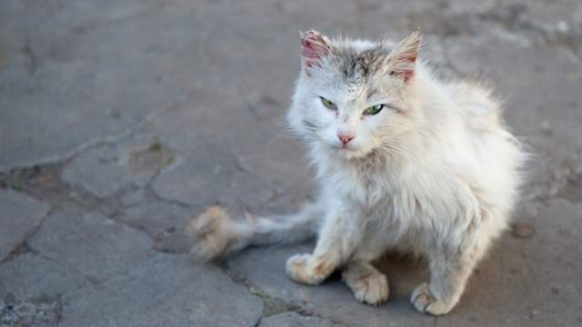
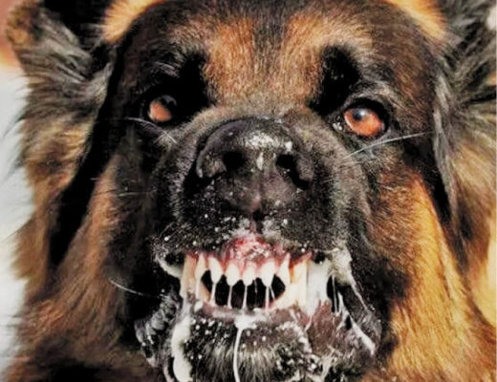
Causes
Rabies infection is caused by the rabies virus. The virus is spread through the saliva of infected animals. Infected animals can spread the virus by biting another animal or a person.
In rare cases, rabies can be spread when infected saliva gets into an open wound or the mucous membranes, such as the mouth or eyes. This could occur if an infected animal were to lick an open cut on your skin.
DO NOT pet him if he looks like a homeless person
You shouldn’t touch or get close to animals when you don’t know whose pet it is and if it doesn’t have any diseases.
DO NOT pet him when he is aggressive
https://www.mayoclinic.org/diseases-conditions/rabies/symptoms-causes/syc-20351821

Slide 6
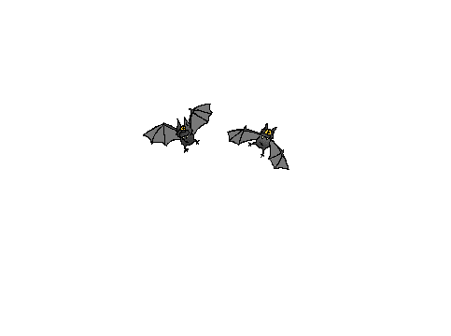
.
Symptoms
Fever
Headache
Nausea
Vomiting
Agitation
Confusion
Hyperactivity
Difficulty swallowing
Excessive salivation
Fear brought on by attempts to drink fluids because of difficulty swallowing water
Hallucinations
Insomnia
Partial paralysis
When to see a doctor
Seek immediate medical care if you're bitten by any animal, or exposed to an animal suspected of having rabies. Based on your injuries and the situation in which the exposure occurred, you and your doctor can decide whether you should receive treatment to prevent rabies.
Even if you aren't sure whether you've been bitten, seek medical attention. For instance, a bat that flies into your room while you're sleeping may bite you without waking you. If you awake to find a bat in your room, assume you've been bitten. Also, if you find a bat near a person who can't report a bite, such as a small child or a person with a disability, assume that person has been bitten.
https://www.mayoclinic.org/diseases-conditions/rabies/symptoms-causes/syc-20351821

Slide 7
What to do when an animal scratch/bite you?
wash the wound thoroughly with running water and soap,
disinfect it with iodine or a wound disinfectant, cover it with a light dressing,
remember where the incident happened, and if you can do it without harming yourself, secure the animal
go to the nearest medical point or doctor as soon as possible.
https://www.hopkinsmedicine.org/health/conditions-and-diseases/animal-bites-and-rabies

Slide 8
Risk factors
Factors that can increase your risk of rabies include:
Traveling or living in developing countries where rabies is more common, including countries in Africa and Southeast Asia
Activities that are likely to put you in contact with wild animals that may have rabies, such as exploring caves where bats live or camping without taking precautions to keep wild animals away from your campsite
Working in a laboratory with the rabies virus
Wounds to the head or neck, which may help the rabies virus travel to your brain more quickly
https://www.mayoclinic.org/diseases-conditions/rabies/symptoms-causes/syc-20351821?DSECTION=1#!

Slide 9
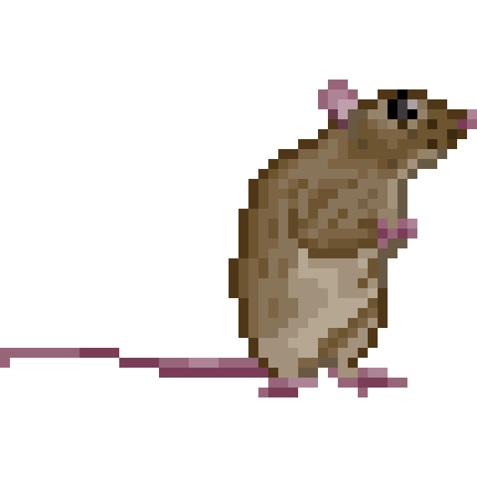
Prevention
To reduce your risk of coming in contact with rabid animals:
Vaccinate your pets. Cats, dogs and ferrets can be vaccinated against rabies. Ask your veterinarian how often your pets should be vaccinated.
Keep your pets confined. Keep your pets inside and supervise them when outside. This will help keep your pets from coming in contact with wild animals.
Protect small pets from predators. Keep rabbits and other small pets, such as guinea pigs, inside or in protected cages so that they are safe from wild animals. These small pets can't be vaccinated against rabies.
Report stray animals to local authorities. Call your local animal control officials or other local law enforcement to report stray dogs and cats.
Don't approach wild animals. Wild animals with rabies may seem unafraid of people. It's not normal for a wild animal to be friendly with people, so stay away from any animal that seems unafraid.
Keep bats out of your home. Seal any cracks and gaps where bats can enter your home. If you know you have bats in your home, work with a local expert to find ways to keep bats out.
Consider the rabies vaccine if you're traveling. If you're traveling to a country where rabies is common and you'll be there for an extended period of time, ask your doctor whether you should receive the rabies vaccine.
https://www.mayoclinic.org/diseases-conditions/rabies/symptoms-causes/syc-20351821?DSECTION=1#!

Slide 10
Recapitulation
10 facts on rabies
Rabies is fatal once symptoms appear
Over 59 000 people die of rabies each year
Education is key for rabies prevention
Wound washing is lifesaving
Vaccination against rabies saves lives
Vaccinating dogs reduces human infection
Reporting of dog bites and suspected rabid animals supports rabies elimination
Technology improves access to rabies treatment in rural and hard-to-reach locations
Rabies is a succes story for implementing One-health
United Against Rabies to achieve “Zero by 30”
https://www.who.int/news-room/fact-sheets/detail/rabies

Slide 11
vocabulary
inflammation of the brain - zapalenie mózgu
violent movements - gwałtowne ruchy
uncontrolled excitement - niekontrolowana ekscytacja
loss of consciousness - utrata przytomności
peripheral nerves - nerwy obwodowe
In addition - dodatkowo
paresis and paralysis of the limbs - niedowład i porażenie kończyn
swallowing disorders - zaburzenia połykania
leakage of saliva - wyciek śliny
open wound - otwarta rana
mucous membranes - błony śluzowe
Agitation - podniecenie
iodine - jodyna
precautions - środki ostrożności
confined - ograniczony
stray animals - bezpańskie zwierzęta

Slide 12
Bibliography:
Rabies
Rabies - Symptoms and causes
Rabies
Wścieklizna u ludzi i zwierząt - objawy, leczenie
Animal Bites and Rabies
Rabies

Slide 13
Thanks for watching
presentation made by: Oliwia Jerzowska Ia

