Slide 1
I WISH THIS WAS RENOVATION OF OLD DESTROYED CLASSES

Slide 2
I WISH THIS WAS STUDENTS LOCKERS

Slide 3
I WISH THIS WAS SOCIAL AREA FOR STUDENTS

Slide 4
I WISH THIS WAS EATING IN SCHOOL

Slide 5
I WISH THIS WAS CHEMICAL SUBSTANCES

Slide 6
I WISH THIS WAS MOTIVATIONAL BOARD

Slide 7
I WISH THIS WAS BIGGER AND MORE EQUIPPED LIBRARY

Slide 8
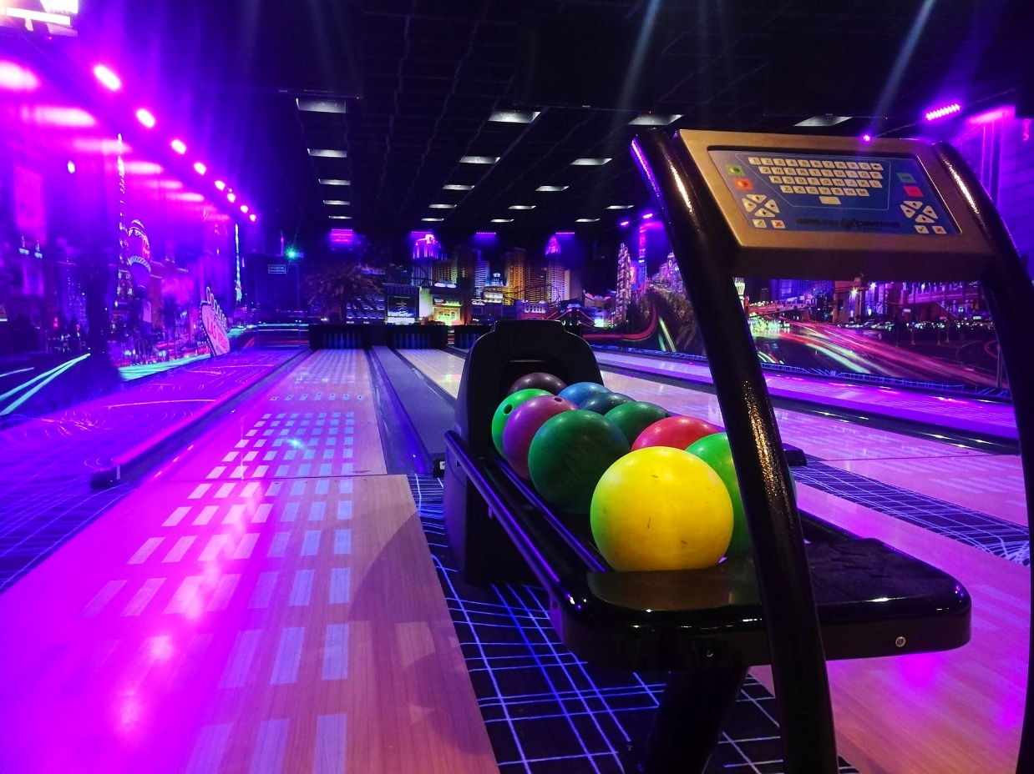
I WISH THIS WAS SWIMMING POOL OR BOWLING ALLEY

Slide 9
I WISH THIS WAS MORE BIKE RACKS NEAR THE SCHOOL

