Slide 1
Ideas for improving our school
We received funding from the local government and decided to spend it on the development of the school.
Here are our ideas.

Slide 2
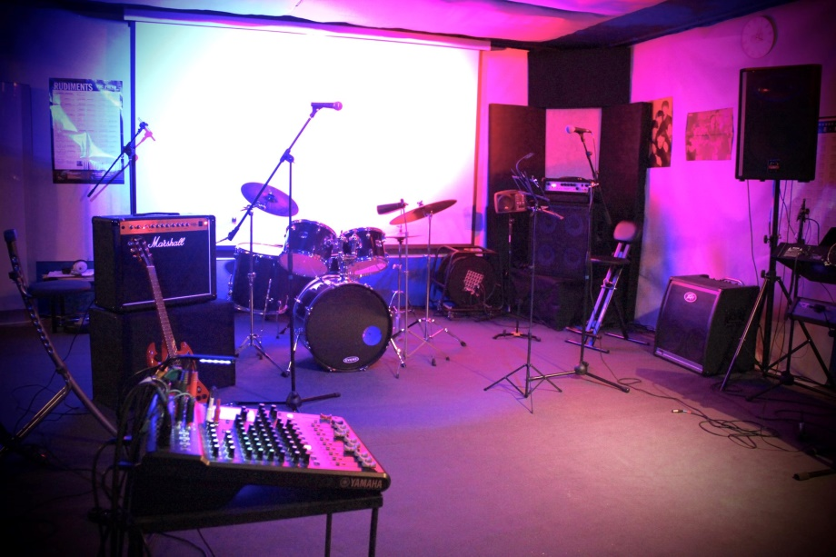
1. Music room
I wish it was a music room with various instruments.
We have a great music band in our school and we think that creating a special room for playing, singing and creating music would be a great gift for them.
There would be the most necessary equipment : of course musical instruments, stands, microphones, speakers. The room would be equipped with acoustic panels that suppress the noise

Slide 3
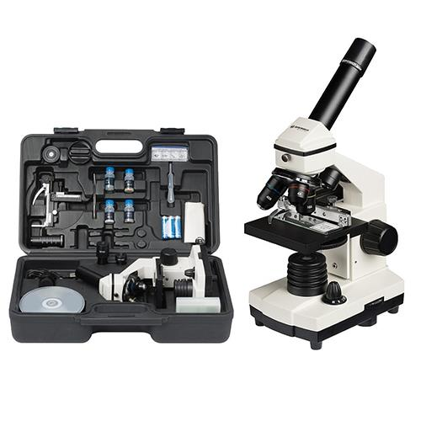
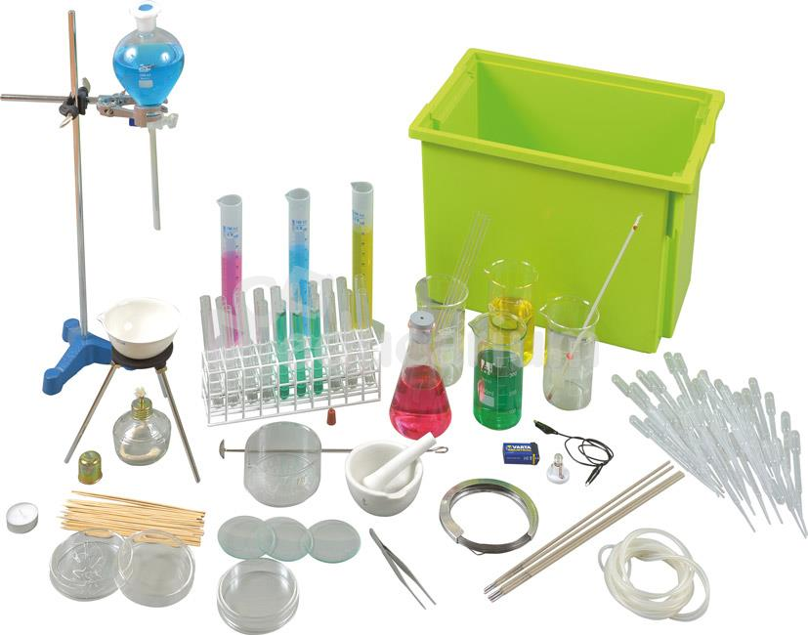
2. Biological equipment
I wish it was an improved biological and chemical equipment.
We thought about buying good quality biological and chemical equipment in order to broaden th students’ knowledge and make more interesting experiences

Slide 4
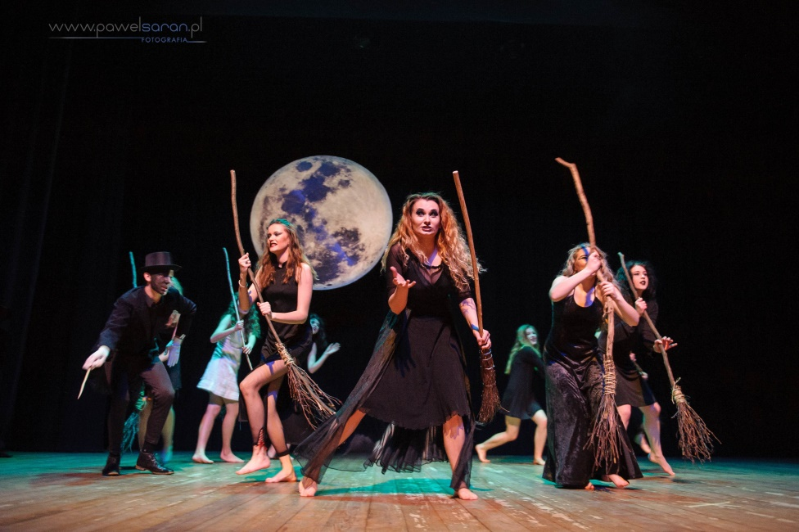
3. Accessories for theater activities
We would like to diversify the theater classes for students by purchasing various costumes and props. Having its own theater classroom, better costumes and professional accessories, the school theater will develop and present better.

Slide 5
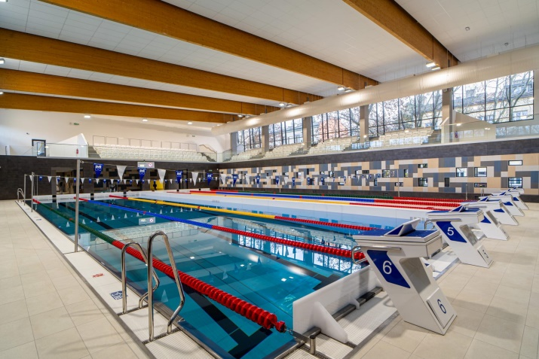
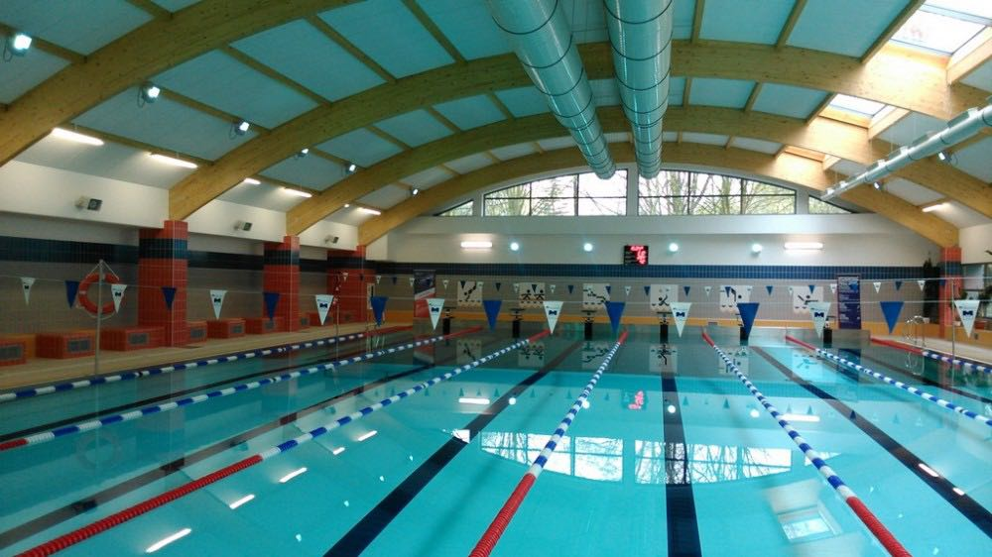
4. Swimming pool
I am sure that if our high school had a swimming pool, many students would have enjoyed a PE lesson more. What's more, regular swimming supports the respiratory system, corrects posture defects, stimulates circulation and has a positive effect on our mood.

Slide 6
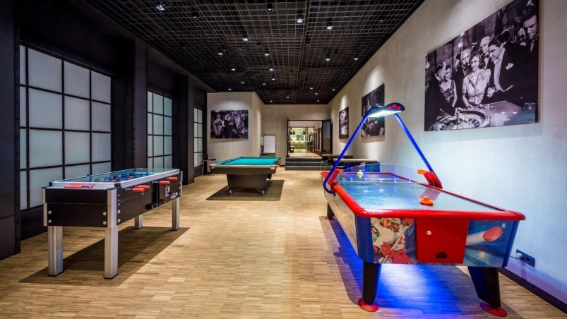
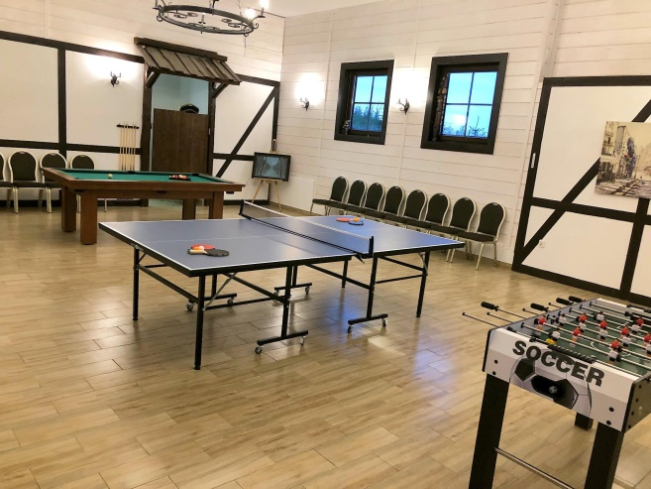
5. Game room
I think our high school could use a room with billiards, football table, ping-pong table, and air hockey. Students would then have the opportunity to spend an interesting break instead of sitting on social media all the time. Such games improve our concentration, teach cooperation and arouse healthy competition.

Slide 7
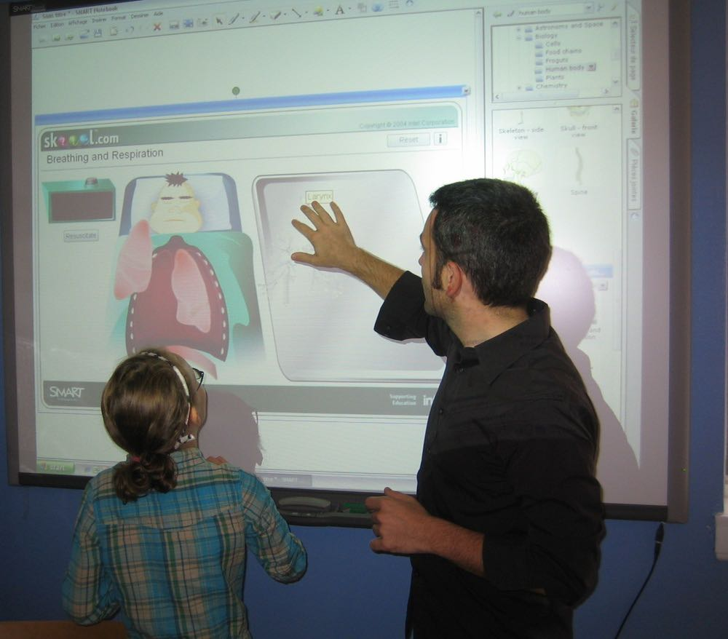
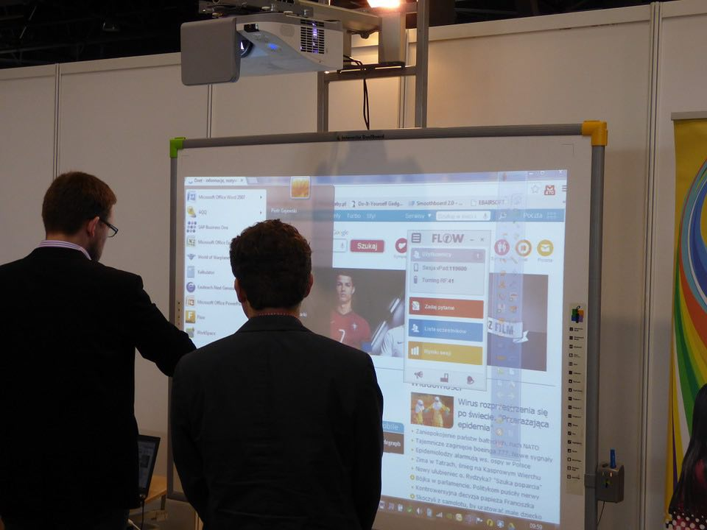
6. Interactive whiteboard
In my view, interactive whiteboards in classrooms are a great and very practical idea. Thanks to many functions they are much more pleasant to use than ordinary whiteboards. I think they would make the teachers' jobs much easier. Because, for example, they could prepare educational materials for classes faster. Students would also benefit as it would increase their engagement in the lesson.

Slide 8
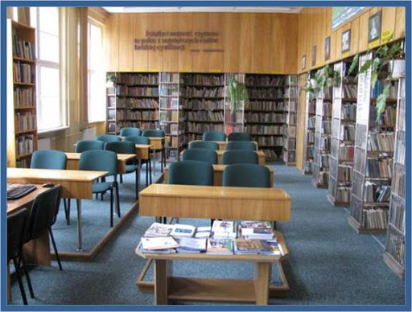
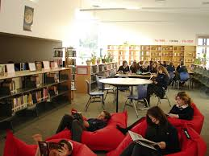
7. Library
I wish this was a large and spacious library where each student could spend a break. It would be an ideal place to study, read a book or just relax. In addition to books, you could put there comfortable sofas or some tables with chairs. Additionally, a computer corner would be useful.

Slide 9
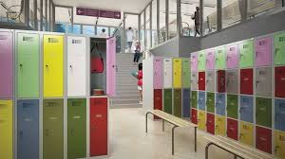
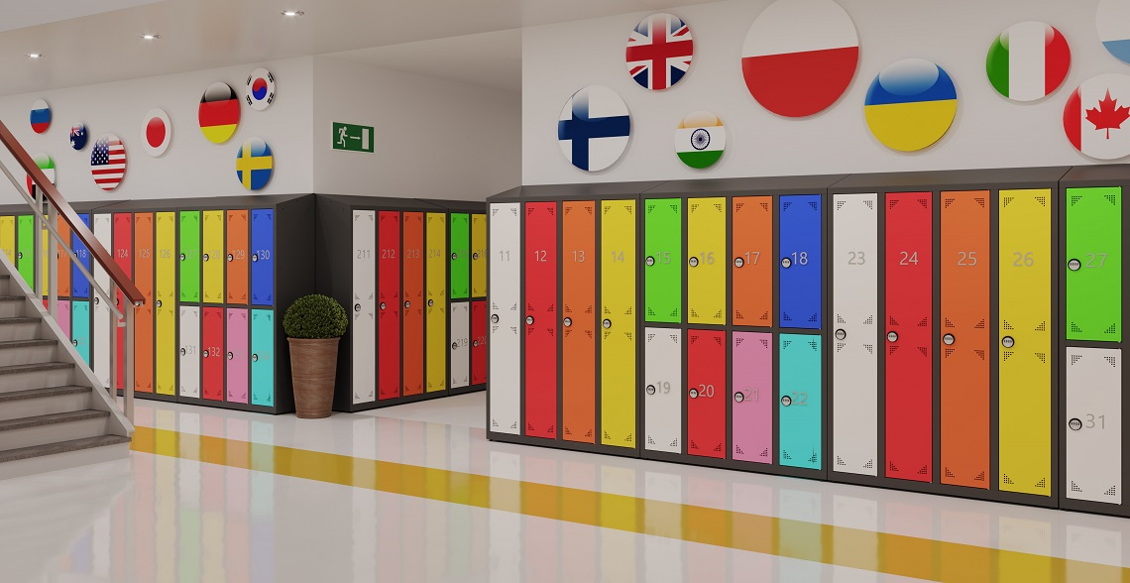
8. School lockers
I wish these were new and larger school lockers. Preferably for each individual or for a maximum of two people. It is best if they had shelves inside, for example for books, and on the sides, hooks for outer clothing. They would be locked and painted in various interesting colors.

Slide 10
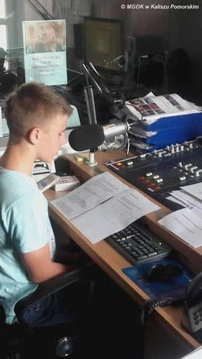
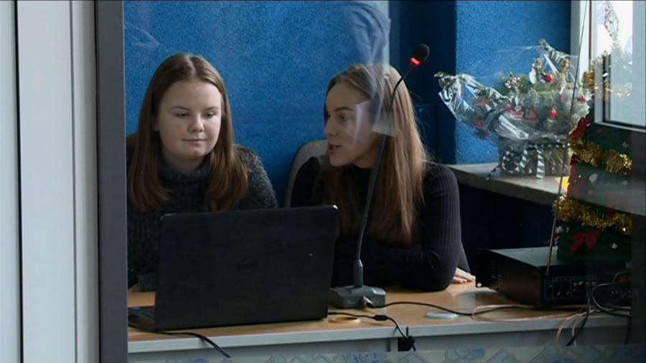
9. Radio station
I wish this was the radio station at our school. Thanks to it, during breaks, important information could be provided or, for example, music played. Such an information system would certainly facilitate the transmission of the message. The students would not have to walk around the classrooms and make announcements, as one announcement in the radio station would be enough.

Slide 11
Thanks for attention
Natalia Skuza, Julia Radek and Marysia Patyk

